Slide 1
Optical communications and data networks (EENGM2001) Week16_Lecture024_ASync_Quantum
Siddarth K Joshi

Slide 2
Why quantum?
Quantum communication offers the highest security possible
Quantum computers represent a massive boost to information processing
We will need to link quantum computers together
Quantum Internet
Quantum sensors can be far more precise than classical ones

Slide 3
Why should you care?
Quantum technologies are highly disruptive
Migration of some infrastructure to “quantum” will be taking place in the next few years
Being aware of the restrictions imposed by quantum is important for new infrastructure now
Massive industry demand for quantum ready workforce
In business theory, disruptive innovation is innovation that creates a new market and value network or enters at the bottom of an existing market and eventually displaces established market-leading firms, products, and alliances

Slide 4
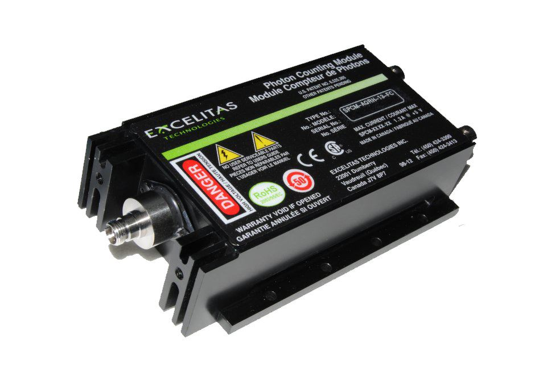
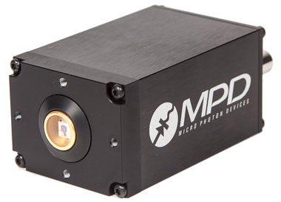
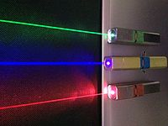
Individual particles of light.
Can be detected.

Slide 5
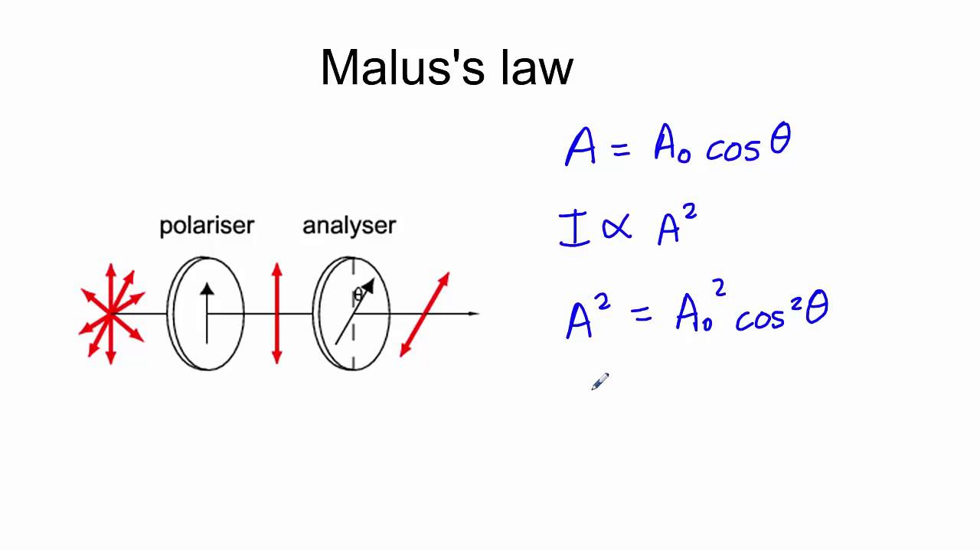
Direction of oscillation of Electric field.
When passing through a polarizer:
Malus’s Law
Can oscillate in any plane.
Can be thought of as mixtures of
each other
Diagonal = ½ Horizontal & ½ Vertical
∣D〉 = 1/√2 (∣H 〉+∣V 〉)

Slide 6
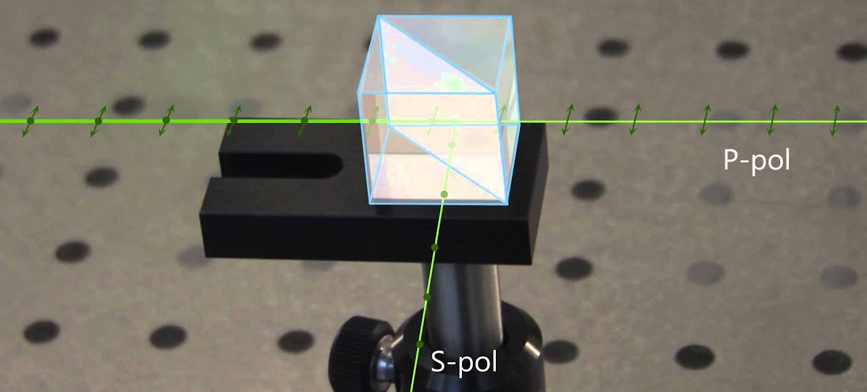
∣D〉 = 1/√2 (∣H 〉+∣V 〉)
What is this strange symbol | > ?
This is the probability amplitude.
Probability amplitude is the square root of the probability
If I pass diagonal light through a Polarisation beam splitter measuring in H&V
Then the output will be 50:50
So Diagonal polarisation must be a combination of H and V
H-Pol
V-Pol

Slide 7
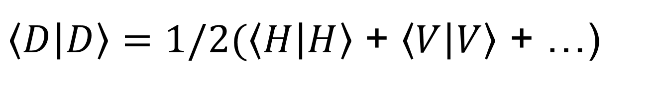
So Diagonal polarisation must be a combination of H and V
∣D〉 = 1/√2 (∣H 〉+∣V 〉)
i.e. if I take the square….
Not just the square, but because we are dealing with complex numbers we multiply with the complex conjugate
$\left\langle D | D\right\rangle =1/2(\left\langle H | H\right\rangle$ + $\left\langle V | V\right\rangle$ + …)
This term cancels out

Slide 8
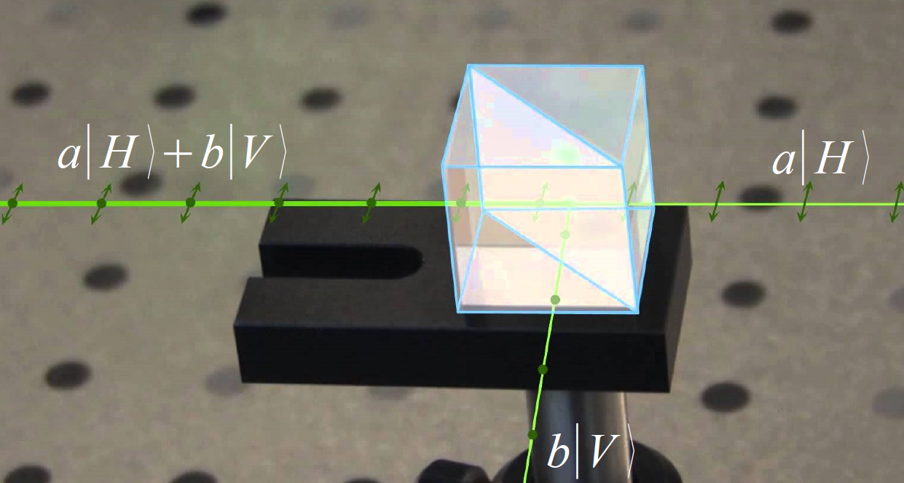
Direction of oscillation of Electric field.
When passing through a polarizer:
Malus’s Law
Can oscillate in any plane.
Can be thought of as mixtures of
each other
For single photons, Intensity = probability
Can also be measured with a PBS
Can be modified without measuring

Slide 9

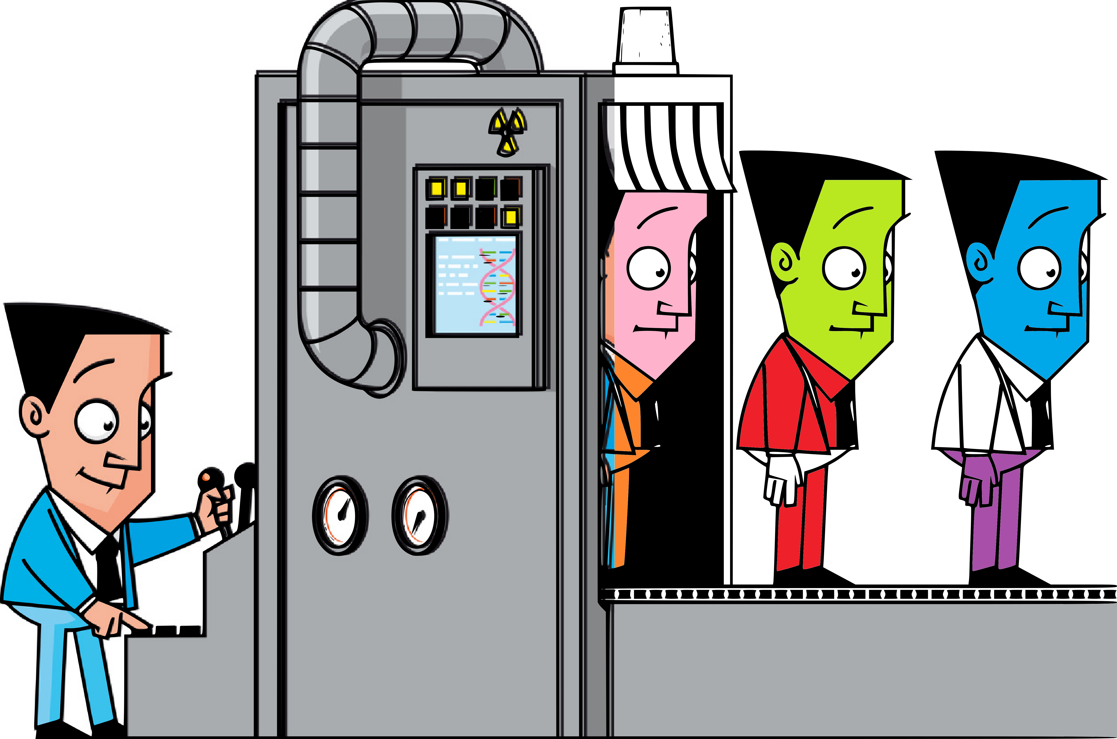
No Cloning
Impossible to create an exact duplicate of an unknown quantum state!
Why?
Measuring a quantum system
changes the system
Eve can only make flawed copies of the
photons A sends B.
I.e., she will introduce errors.
Alice and Bob can detect these errors
and thus Eve.
https://www.youtube.com/watch?v=owPC60Ue0BE
The link is clickable in the video as well ☺

Slide 10
Wave particle duality:
In this MZI, single photons show wave like interference but particle like detection

Slide 11
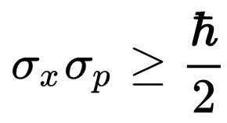
Uncertainty principle:
Impossible to know the exact position and momentum at the same time
Momentum and position are just examples of conjugate variables
Wave vector (momentum of a photon) and polarisation are another pair.
Energy-time,
https://www.youtube.com/watch?v=TQKELOE9eY4
The link is clickable in the video as well ☺

